Slide 1
Firebase Hosting
Software Studio 軟體設計與實驗
Hung-Kuo Chu
Department of Computer Science
National Tsing Hua University
CS2410

Slide 2

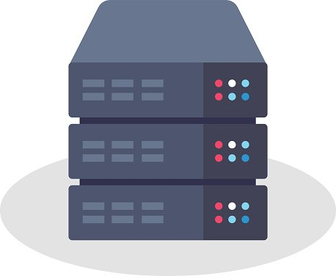
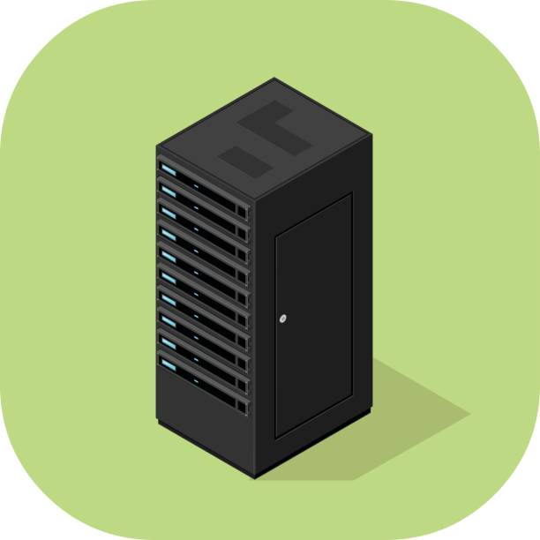
Basic Web Workflow
Request: Website
Response: IP address
DNS Server
Client
Request: IP address
Response: Data
Main Server

Slide 3

What is Firebase?
Firebase is an application cloud development platform built by Google.
Help developers quickly set up backend services in the cloud which effectively shorten the application development time.

Slide 4
Step by step
1. Create a new Firebase Project
2. Create a new Web App on Firebase Console
3. Install the Firebase CLI
4. Host Your Webpage

Slide 5

1. Create a new Firebase Project
Go to Firebase Console (need a Google account) and add a project
This id will be used in database URL and webpage domain.
Please record it!

Slide 6

2. Create a new Web App on Firebase Console
Firebase Console

Slide 7
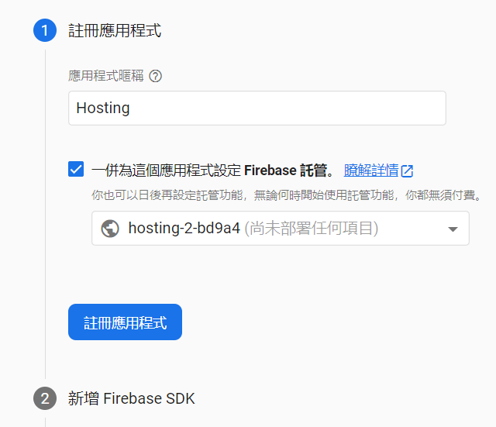
Initialization Configuration
Pick a name for your application

Slide 8
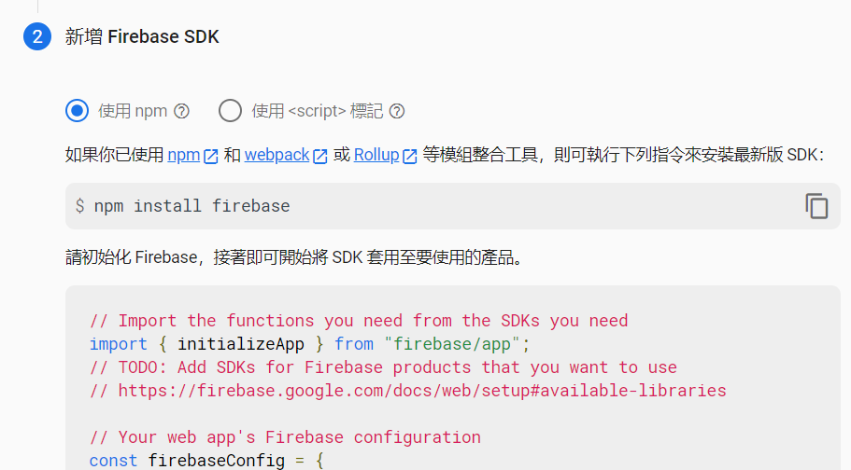
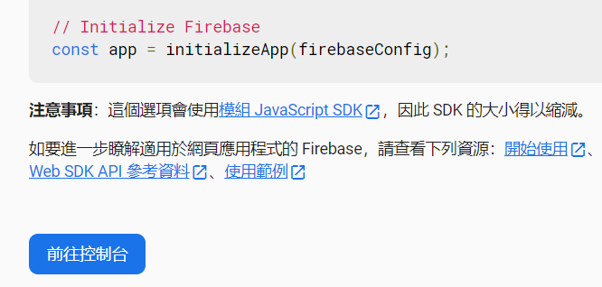
Initialization Configuration
Skip this step

Slide 9
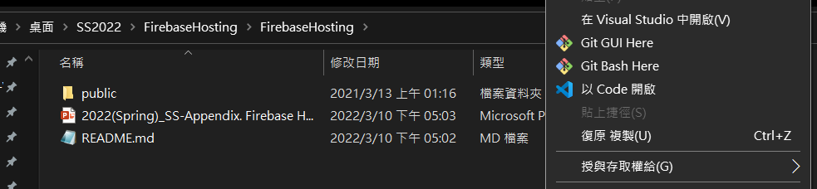
3. Install the Firebase CLI
Download node.js, 12.16.2 LTS
Start VSCode at your project directory, not in the public folder.

Slide 10
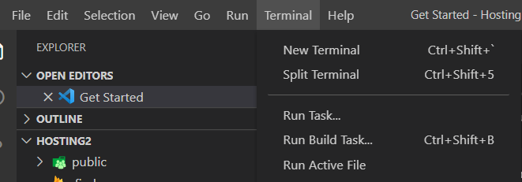
3. Install the Firebase CLI
Run the command at your project directory and complete all settings
npm install -g firebase-tools
firebase login
firebase init

Slide 11
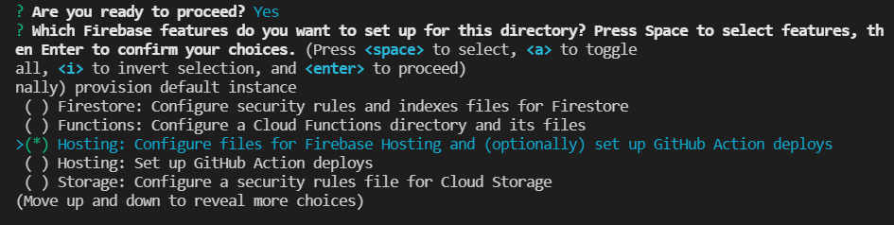
Firebase Initialization
Press <space> to select Firebase features.
Select “Hosting”

Slide 12
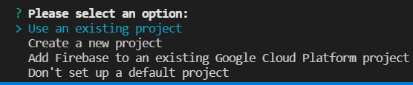
Firebase Initialization
Choose “Use an existing project” and select your Firebase project.

Slide 13

Firebase Initialization
Just press “Enter” to use default settings.

Slide 14
4. Host Your Webpage
Run the command at your project directory
firebase deploy
Your app will be deployed to the domain <YOUR-FIREBASE-APP>.firebaseapp.com

Slide 15
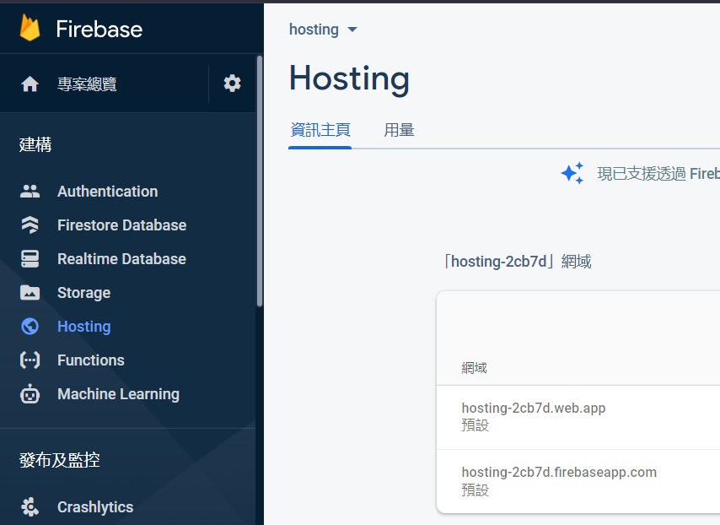
4. Host Your Webpage
If you forget the address, go to firebase console.

